Slide 1
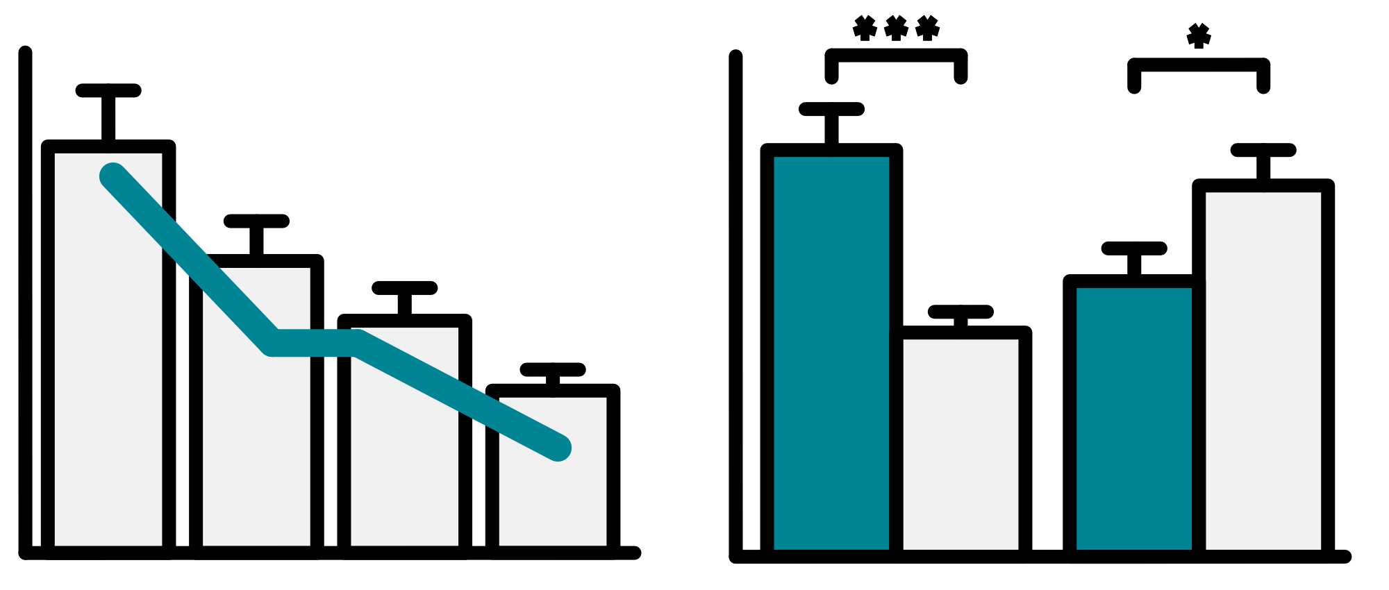
Logo goes here
PUT YOUR TITLE HERE - IT CAN BE RELATIVELY LONG AS MANY POSTER TITLES ARE
Poster Presenter₁, Author Two₁, Author Three₂, Author Four₃
1. Institution One, Location, Country, 2. Institution Two, Location, Country, 3. Institution Three, Location, Country
1
INTRODUCTION
2
METHODS
In our ambitious quest to redefine the very essence of scientific poster creation, we embarked upon a journey that transcended the mundane confines of conventional academia. Our mission, executed with a vibrant palette of colors and a legion of fervent design enthusiasts, was to thrust the time-honored tradition of poster presentations into a bold new era, one where aesthetics and information converge seamlessly to craft a narrative that leaves an indelible imprint on the minds of our audience.
This study endeavors to unearth the hidden treasures of crafting scientifically captivating posters. We sought to harness the potent alchemy that fuses data and design, transforming these information-laden canvases into dynamic, visually immersive experiences. Our ultimate aspiration is to revolutionize the very way we communicate scientific insights.
Our experimental methodology was a nuanced dance between pixels and imagination, akin to composing a symphony with fonts, layouts, and graphics as our notes. We ventured into uncharted territories within the scientific sphere of design, challenging convention and embracing creativity. Our creative laboratory evolved into a vibrant space where precision and artistic intuition coexisted harmoniously, guiding us toward pioneering the era of visually arresting scientific posters.
Every element was scrutinized and tested, not just for aesthetic appeal but also for its profound impact on viewer engagement and comprehension. Each choice, from the color scheme to the font selection, was subjected to meticulous evaluation, ensuring that our creative endeavors were firmly rooted in both artistic innovation and scientific rigor.
STEP 1
STEP 2
STEP 3
STEP 4
3
RESULTS
After countless iterations, sleepless nights, and the relentless pursuit of artistic excellence, we stand on the precipice of unveiling the fruits of our artistic odyssey. Our findings herald a watershed moment in the symbiotic relationship between visual elements and the assimilation of scientific information.
Here is a really cool data table which shows a lot of the information which we are trying to convey in the concise way possible whilst looking visually pleasing.
The strategic integration of colors, fonts, and imagery has harnessed an unprecedented level of viewer engagement. As a consequence, the eyes of our audience were not merely opened; they were widened in astonishment, brows were raised in admiration, and, on occasion, gasps of awe filled the room.
Our data offers irrefutable proof that scientific posters, when infused with the alchemy of artistic finesse, possess the power to captivate audiences in ways that were previously beyond imagination.
The artistic and scientific synergy we've uncovered in this endeavor serves as a testament to the transformative potential of visual storytelling within the world of scientific poster design. It beckons us to break free from the bonds of formulaic presentations, unlocking an exciting realm of engagement that defies convention. Check out my circles below to see how to count from one to four using different shades of colour.
Column 1
Column 2
Row 1
Species | Site 1 | Site 2 | Site 3
Arctotis | 122 | 335 | 99
Symphyotrichum | 443 | 566 | 234
Felicia amelloides | 56 | 778 | 102
Osteospermum | 12 | 0 | 266
Berlandiera lyrata | 22 | 56 | 77
Echinacea | 334 | 45 | 87
Row 2
Figure 2: Title of figure
In this panel, we capture the beauty of serendipity in everyday life. Each image unveils a story, a moment frozen in time, reminding us that the unexpected can often be the most delightful. From fleeting rainbows to chance encounters, these snapshots celebrate the art of being in the right place at the right time. Life's little surprises are the true treasures we cherish.
Figure 1 - Figure Title
In this succinct table, complex information finds clarity. Every row and column is a gateway to essential insights, presenting a condensed narrative of our study. In the realm of minimalism, this small table packs a punch, distilling volumes of data into bite-sized, digestible portions.
1
2
3
4
4
DISCUSSION
5
CONCLUSION
The implications of our study reach far beyond the confines of mere poster presentations; they strike at the very heart of academic discourse itself. The union of aesthetics and science, as witnessed in this exploration, ignites a spark of curiosity and passion within the scientific community.
This study affirms that scientific posters, when enhanced by artistic ingenuity, can become conduits for sparking dialogues, bridging gaps, and amplifying the dissemination of knowledge. It urges researchers to shed their inhibitions and embark on a creative voyage where imagination intertwines harmoniously with scientific rigor. The result? Poster presentations that transcend the ordinary, that move beyond being mere conduits of information and instead become dynamic, engaging experiences for viewers.
In conclusion, our study offers an unequivocal endorsement of the transformative potential that lies at the intersection of art and science within the domain of poster design. It can be a great tool to highlight and/or bold a statement in your conclusion which you are trying to get across to the audience.
By infusing the power of visual storytelling into our presentations thereby unlocking an entirely new realm of engagement and understanding.
Figure 3: Title of figure
In this intricate choreography of data points, we witness the elegant pas de deux between variables X and Y. As they twirl through the graph, notice the graceful arcs and dramatic sweeps, each step revealing a new facet of their intricate relationship.
No
Yes
REFERENCES
https://www.pexels.com/photo/selective-focus-photography-of-white-daisy-flower-122611/
https://www.pexels.com/photo/white-5-petaled-flower-67608/
Inserting a QR code with a link to digital poster, contact info or more information can be useful
https://high-qr-code-generator.com/
https://chromewebstore.google.com/detail/qr-code-generator/afpbjjgbdimpioenaedcjgkaigggcdpp
https://www.pexels.com/photo/a-white-flower-in-bloom-7815538/
https://www.pexels.com/photo/white-flower-with-green-leaves-8661596/

Slide 2
TITOLO
(Suggerimento: se l'intestazione è troppo lunga, riduci la dimensione del carattere)
Presentatore poster₁, Autore due₁, Autore tre₂, Autore quattro₃
1. Istituzione uno, Località, Paese, 2. Istituzione due, Località, Paese, 3. Istituzione tre, Località, Paese
1
INTRODUZIONE
2
METODI
Testo introduttivo
Testo dei metodi o figura/immagine facoltativa
Testo dei metodi o figura/immagine facoltativa
3
RISULTATI
Testo dei risultati sezione 1
Testo dei risultati sezione 2
Figura 2 - Titolo della figura
Didascalia
Figura 1 - Titolo della figura
Didascalia
4
DISCUSSIONE
5
CONCLUSIONI
Testo della discussione o figura/immagine facoltativa
Testo della discussione o figura/immagine facoltativa
Testo conclusivo
REFERENZE
Referenze/riconoscimenti + QR code opzionale
Referenze/riconoscimenti + QR code opzionale

